Slide 1

Chhatrapati Shivaji Institute of Technology
Project Title
Agroforestry
(Disease Detection in Crops using ML)
Team Members :
Abhigyat (CSE) - 300302220011
Jitendra (CSE)– 300302220012
Durgeshnandni (IT) - 300303320002
Chetan (IT) - 300303320003
Guided By :
Mr. Prabhas Gupta
(Head of Department)
(CSE/IT)

Slide 2
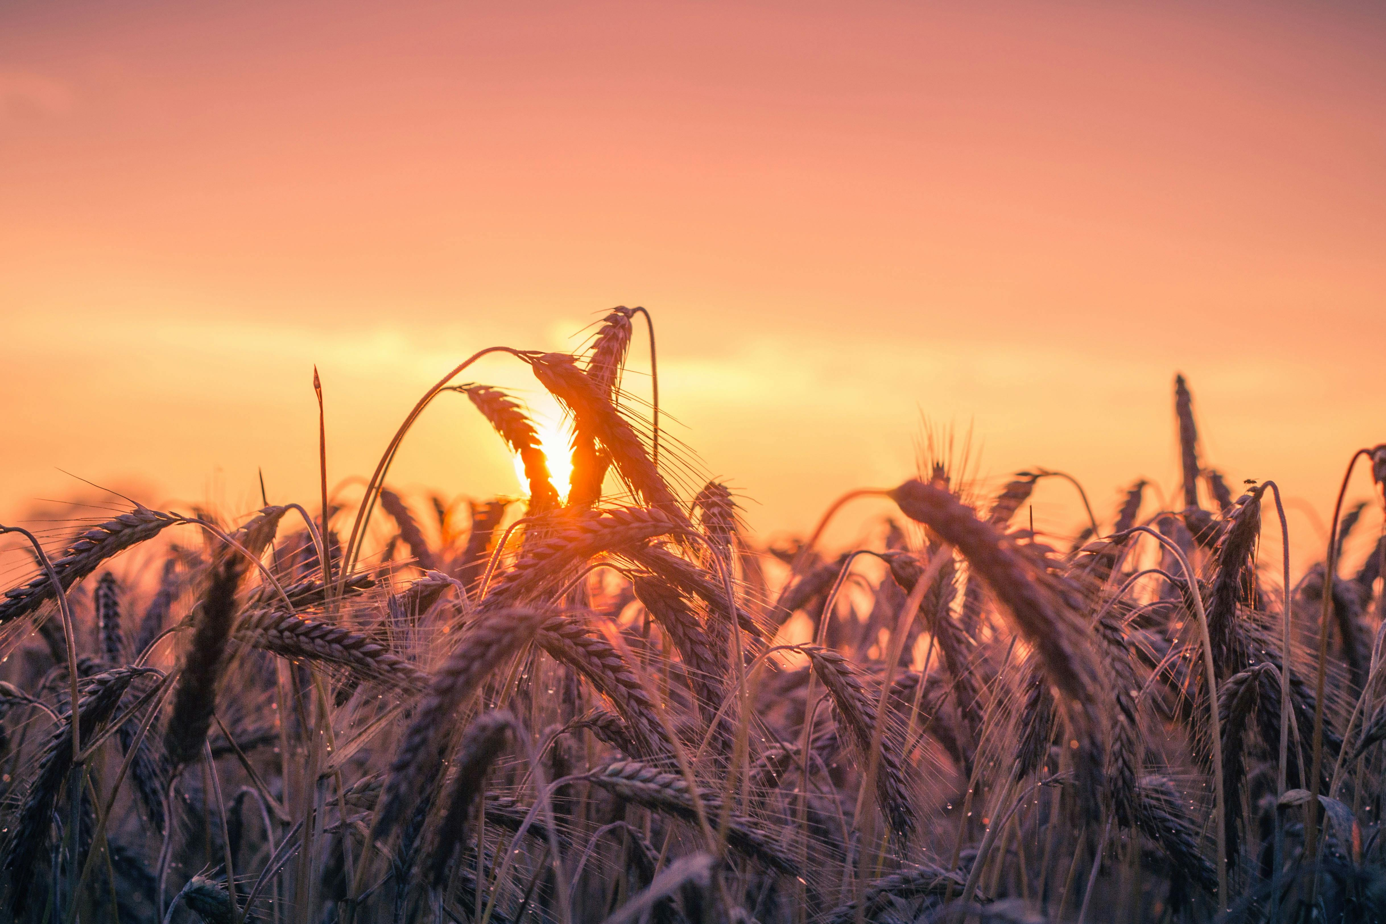
Contents
Introduction
Primary goals
Requirements
Technology used
Methodology
Data flow diagram
Training Results
Testing Results
Future scope
conclusion

Slide 3
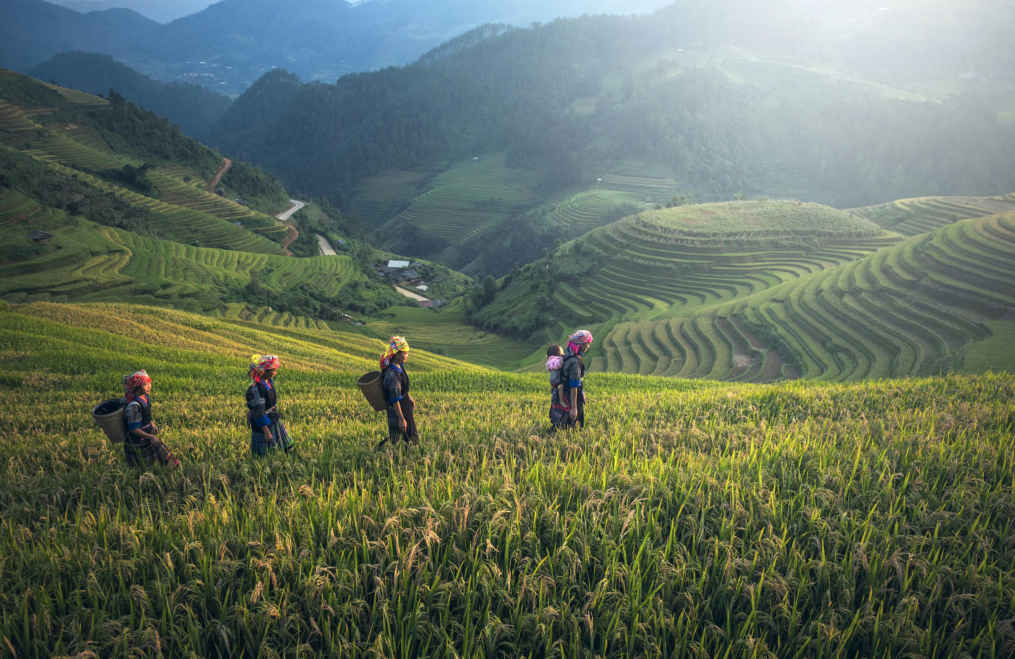
HISTORY
Agriculture is a largest occupation of India, in India more than 60% people are engaged in agriculture. There are most of industries who are based in agriculture for their raw materials.
Agriculture is known as backbone of India because it contributes 18% in India’s GDP.

Slide 4
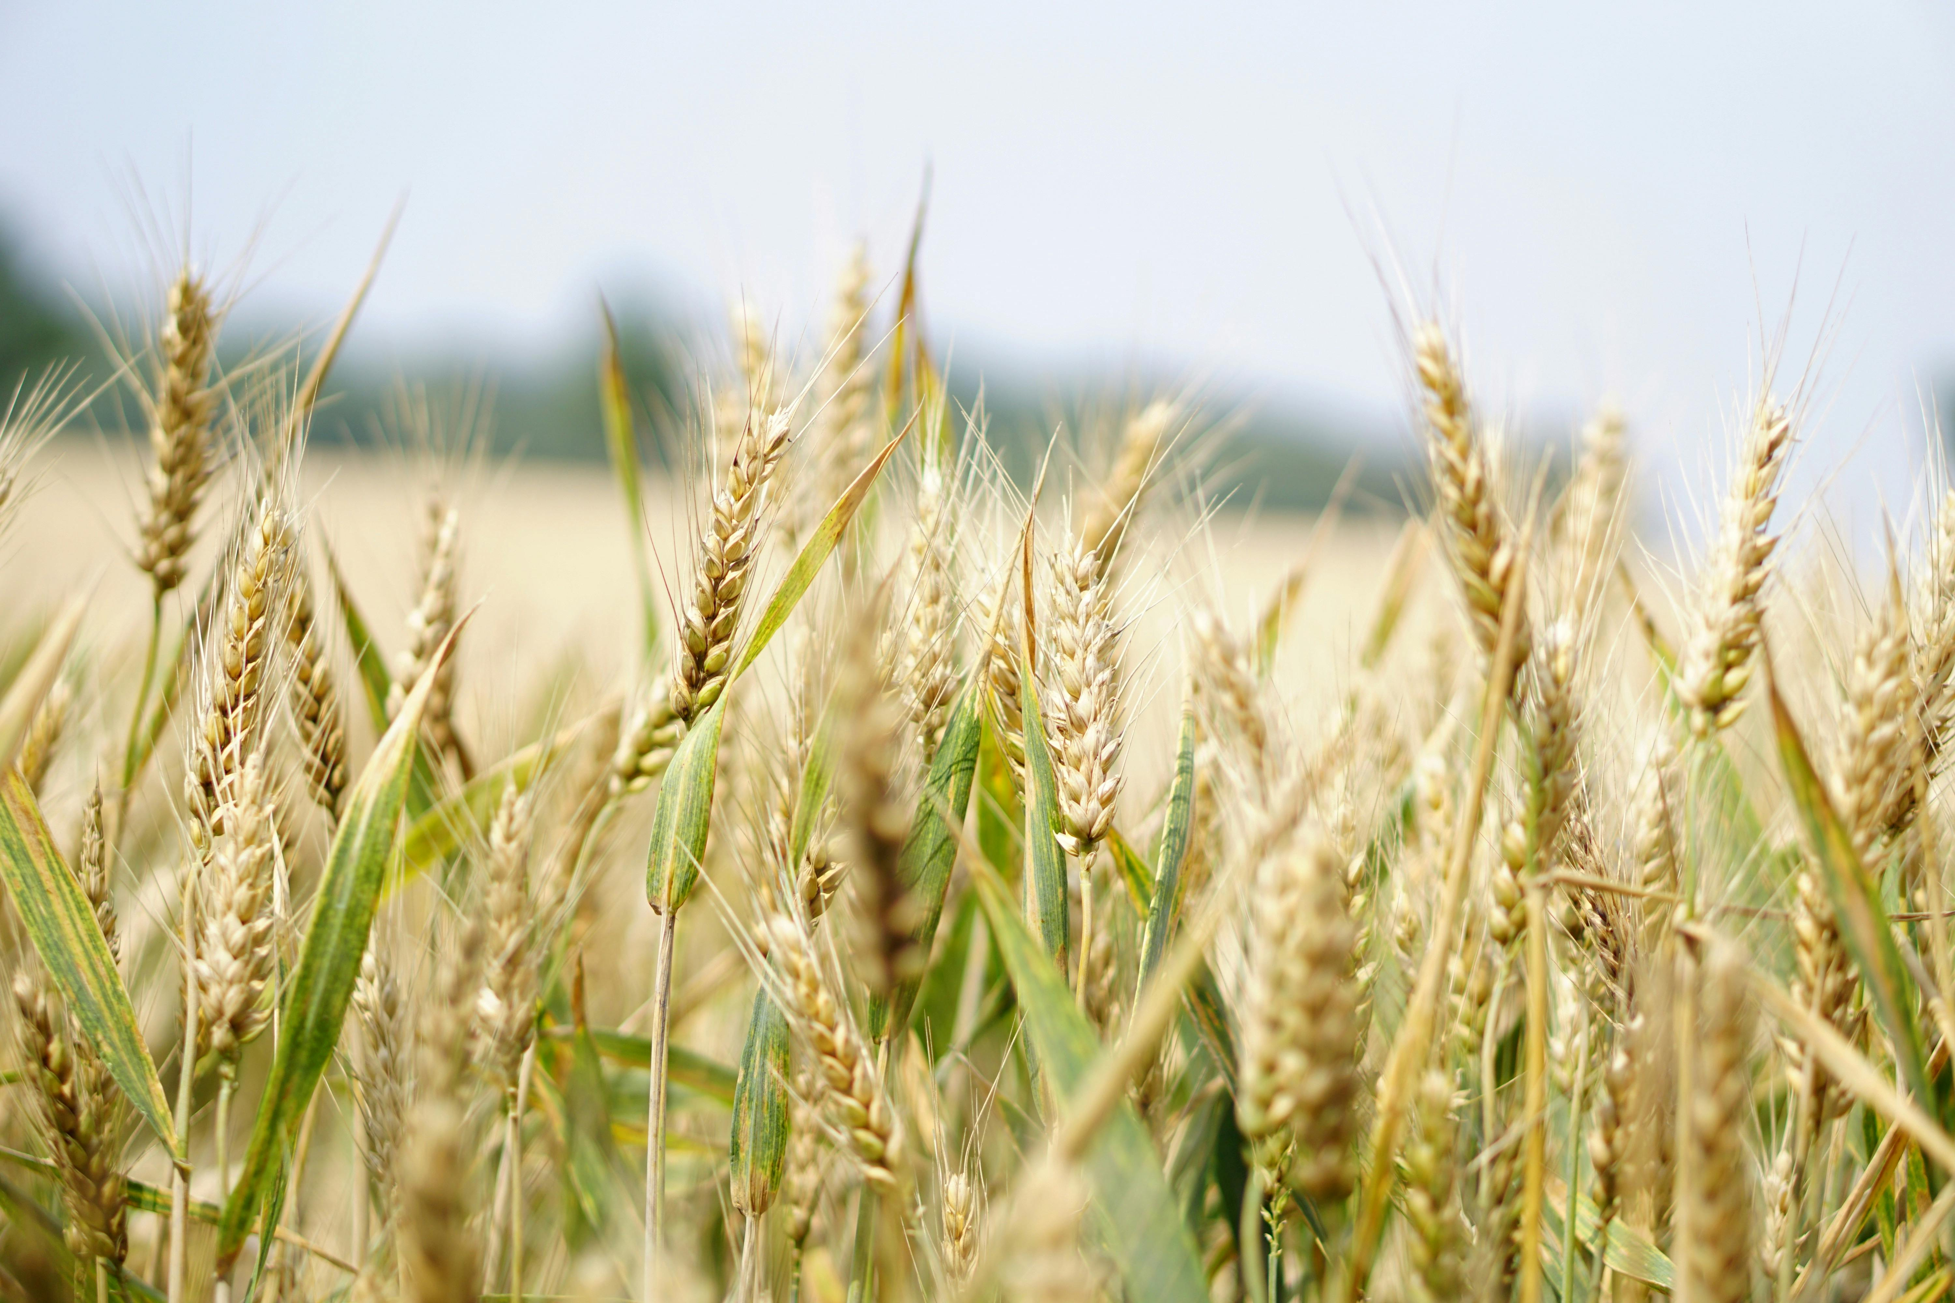
Introduction
AgroForestry is a website which helps farmers to detect disease in there plants and crops also provide appropriate measures cure the plantation.
This website will help farmers to detect the disease in very early stage by its user-friendly nature.
Using appropriate ML algorithms like CNN, this website recognizes the disease in plants and provide information to cure it.
The plant disease prediction application, the user can input an image of a diseased plant leaf, and the application will predict what disease it is and will also give a little background about the disease and suggestions to cure it.

Slide 5
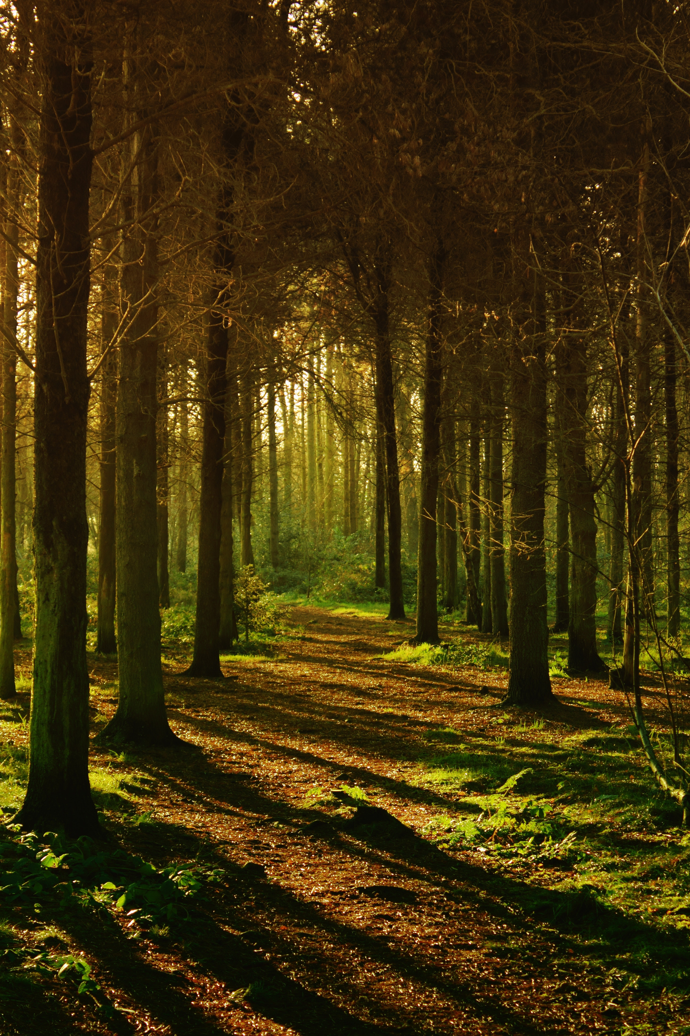
OBJECTIVE
Our Objective is to detect diseases in plants and crops so that farmer can easily cure those diseases from their plants and crops.
The Objective is also to provide necessary information about the disease and its medication.

Slide 6
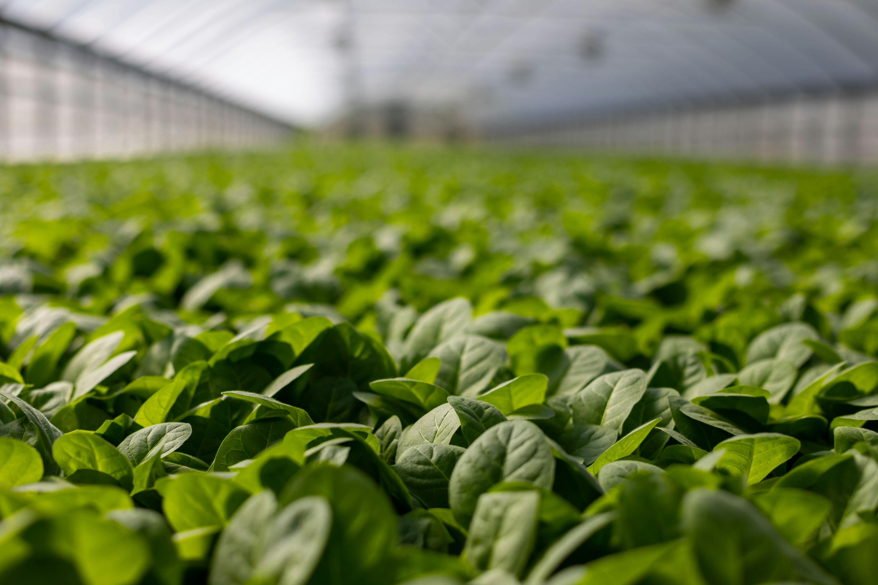
SUMMARY
By summarizing this project we can say that this project helps farmers and gardeners to protect their plants and crops from diseases at early stage without having any severe damage to the plantation .
This project helps farmers by providing information about diseases and about its medication.

Slide 7
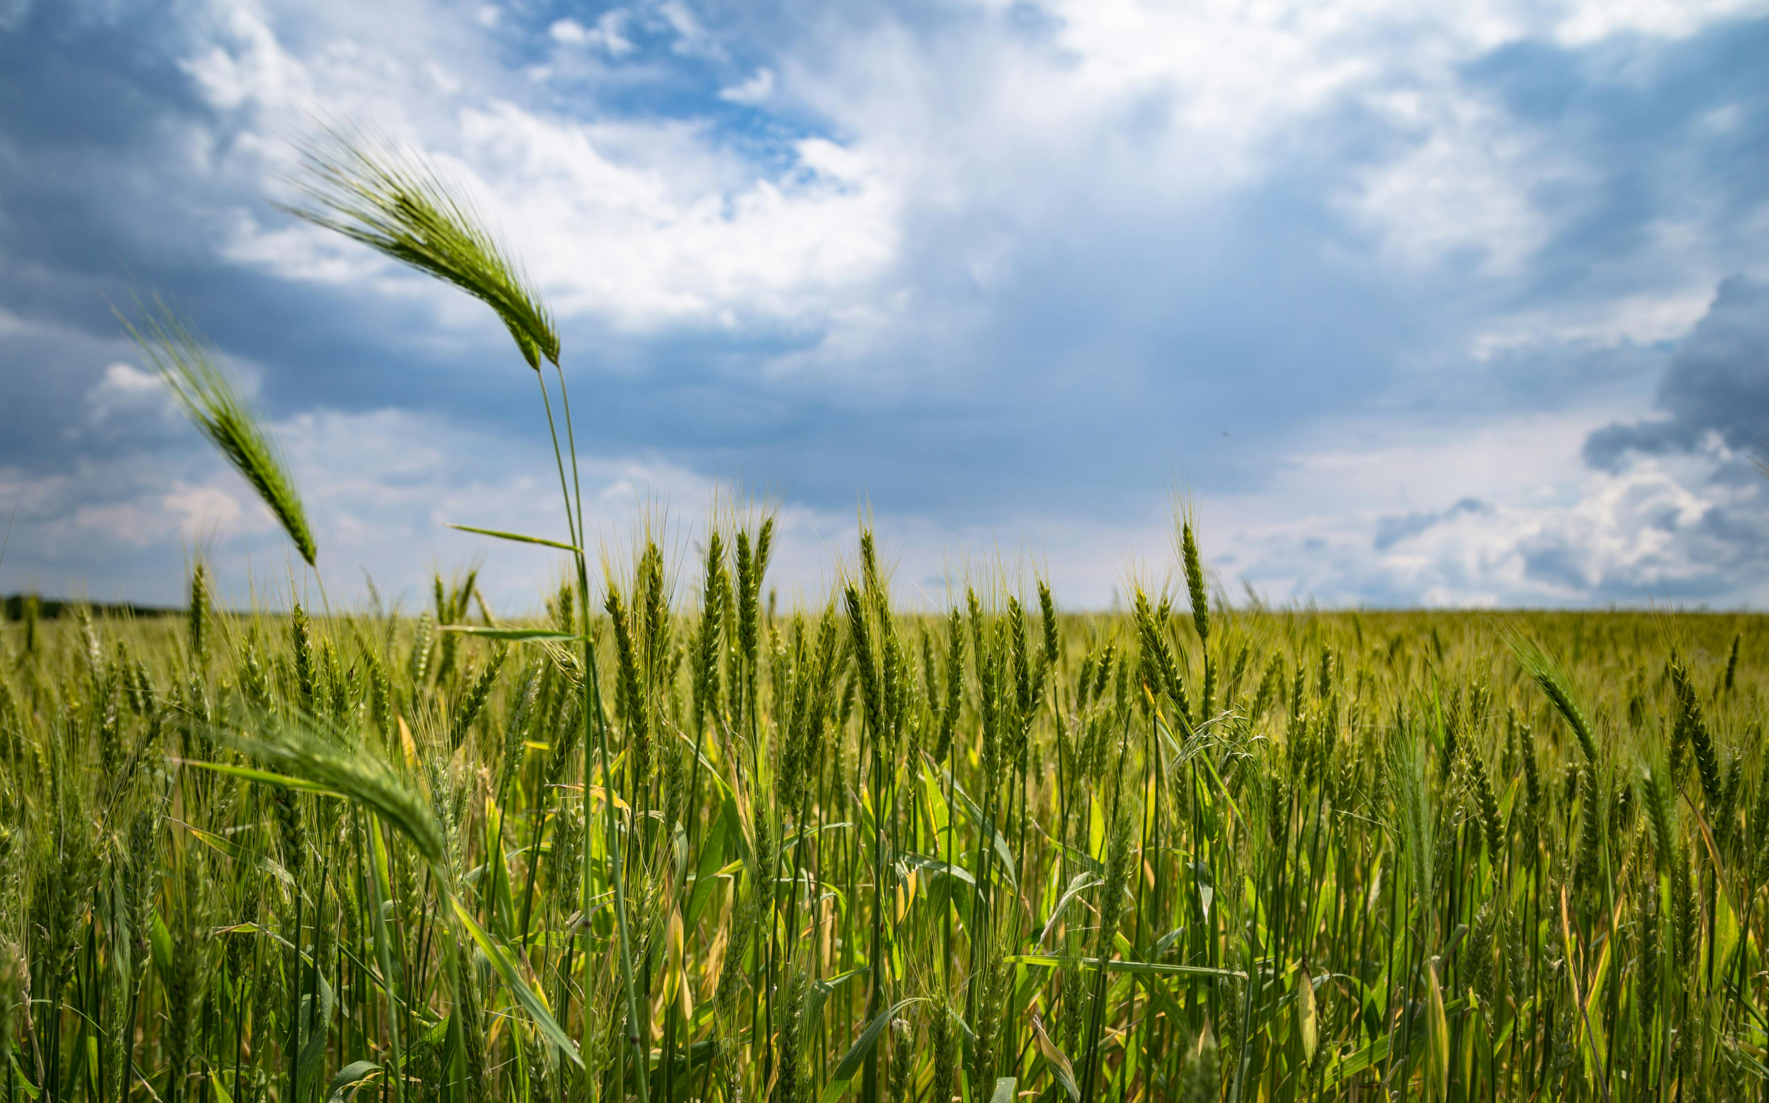
Primary Goals
Early detection of diseases : Identify diseases in crops/plants at their earliest stages.
Accurate prediction : Increase the accuracy of disease prediction using machine learning algorithms.
User-Friendly Interfaces : Easy to use, simple and interactive user interface.
Effective Treatment : Helps taking appropriate measure for the treatment of the crop/plants.
Awareness about Common Diseases : Helps to get knowledge of common diseases in crops/plants.

Slide 8
GAPS IN LITERATURE
The gaps in Agricultural research include under-representation of important topics such as gender , social networks and institutions in the literature on adaptation in agriculture .
There are also noticeable datagaps in agricultural research focused on nutrition and diet , as well as gender and inclusivity.
Another gap is the asymmetry of investment in crop research , which leads to lost opportunities for identifying new sources and combinations of traids and alleles.

Slide 9

Requirements
Hardware
Software
CPU – Intel i5 minimum
Memory – 8GB minimum
Hard Drive – 10 GB free space minimum
GPU – Dedicated GPU For better performance
IDE – PyCharm
Web Browser – Chrome, Edge
Operating System : Windows 10 and up

Slide 10
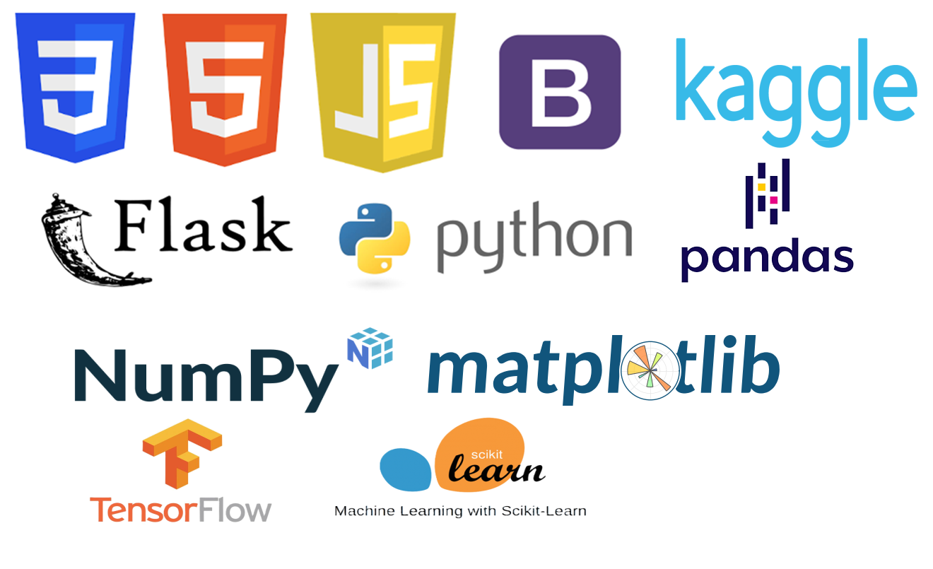
Technologies used
Frontend : HTML, CSS, JAVAScript, BOOTstrap, flask
backend : python, Predefined Dataset, Mysql
Libraries : pandas, matplotlib, Tensorflow, Numpy, seaborn, sci-kit-learn

Slide 11
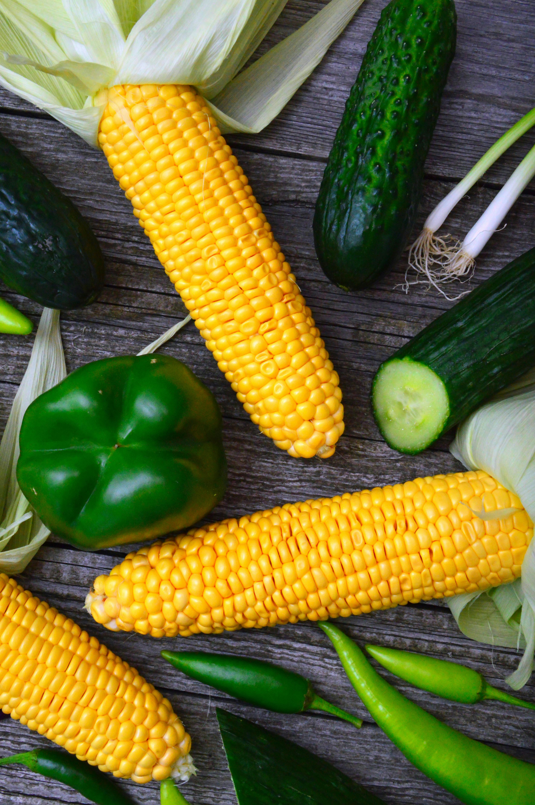
Methodology
In this section, the basic methodologies used to develop the model are discussed :
Data Preprocessing
Building Model
Evaluating Model
Accuracy Visualization
Confusion Matrix Visualization
Predicting Model
Deployment

Slide 12
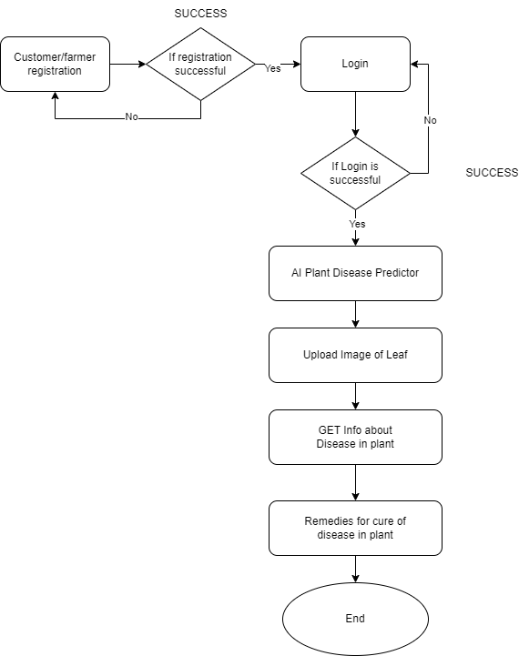
Data flow diagram

Slide 13
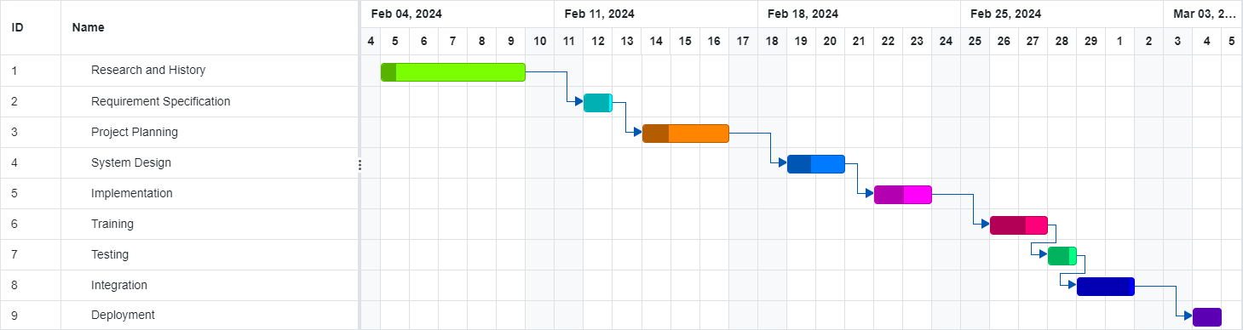
Gantt chart

Slide 14
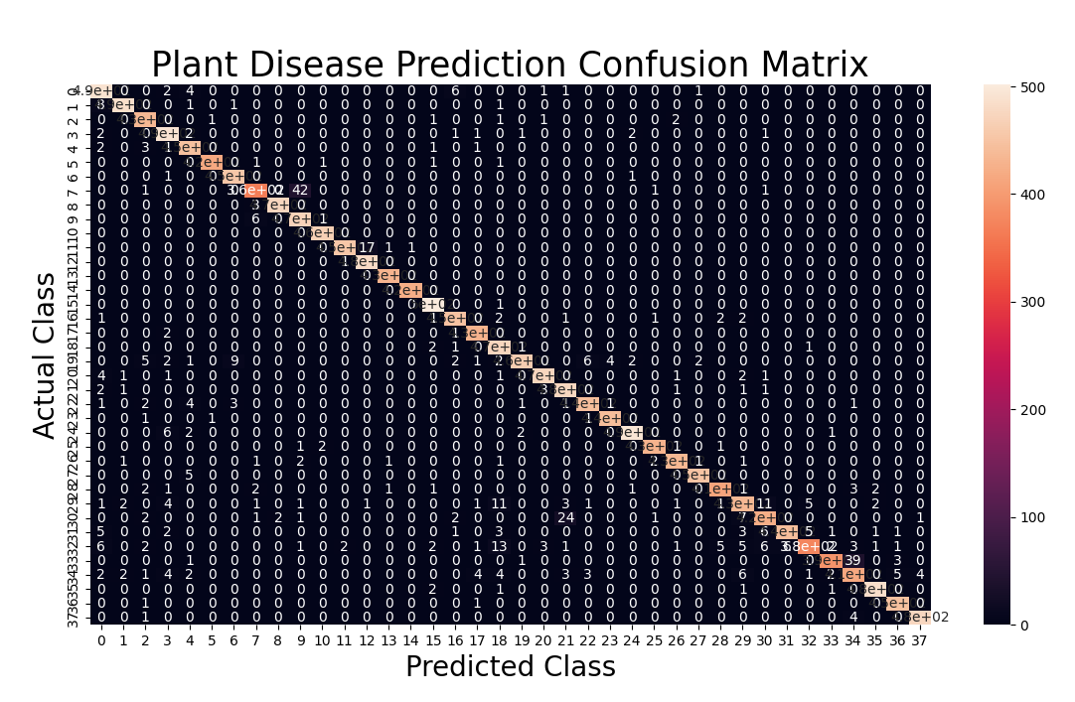
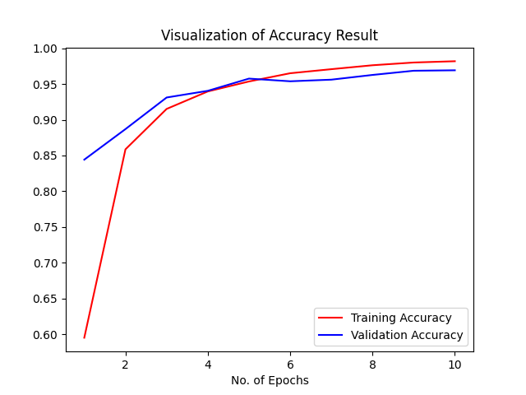
Training Results

Slide 15
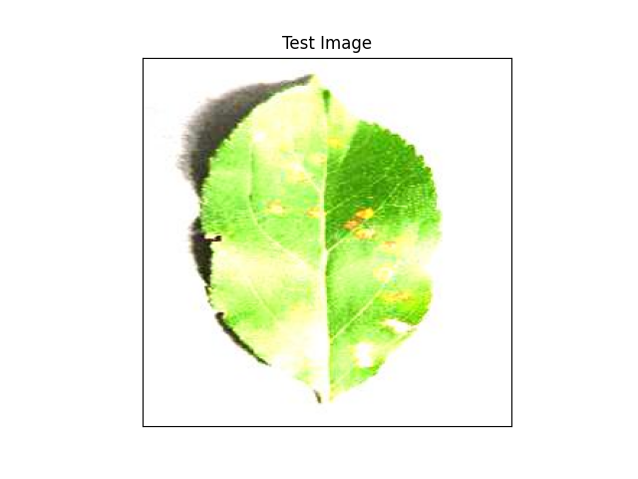
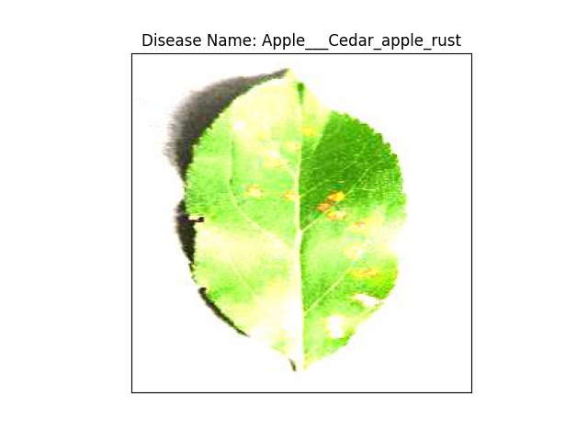
TESting Results

Slide 16

Future scope
We wish to keep working on our project to make it a marketable and leading product. Some of the additions that we feel are needed for it to happen are :
Make it deployable on Cloud for global accessibility.
Adding Fertilizer recommendation section in future to help farmer to use best fertilizer required at the moment.
Adding E-commerce section in future ease of accessibility of goods required for farming.
Predicts and filter the product as per the user’s behaviour and track all user activity for future recommendations using collaborative algorithm with cosine similarity.

Slide 17

conclusion
At last we conclude that our model predicts different types of disease in plant/crop and after predicting it gives solution or remedies to cure or prevent from diseases. We hope that this particular predicting model will definitely help farmer to grow their crops and plants efficiently without any type of issues related to farming.

Slide 18

Thank you

